Slide 2
Jesus the Serpent

Slide 3
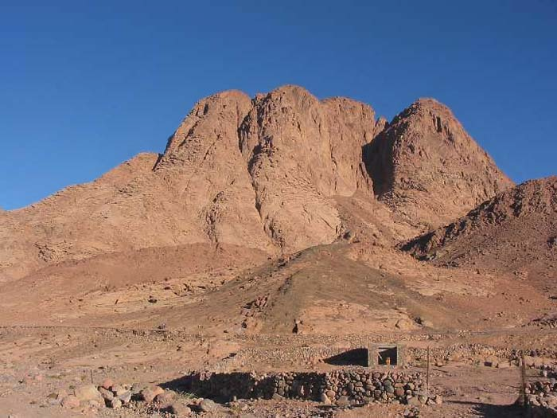
Numbers 21
21:4-5 “discouraged” (‘impatient’)
21:6 Wow !

Slide 4
Deuteronomy 8:15 “who led you through that great and terrible wilderness, in which were fiery serpents and scorpions and thirsty land where there was no water…”
1 Corinthians 10:9 “nor let us tempt Christ, as some of them also tempted, and were destroyed by serpents”

Slide 5
Ephesians 4:29 “Let no corrupt communication proceed out of your mouth, but what is good for necessary edification, that it may impart grace to the hearers”
Ephesians 4:30 “And do not grieve the Holy Spirit of God, by whom you were sealed for the day of redemption”
Ephesians 4:31 “Let all bitterness, wrath, anger, clamor, and evil speaking be put away from you, with all malice”

Slide 6
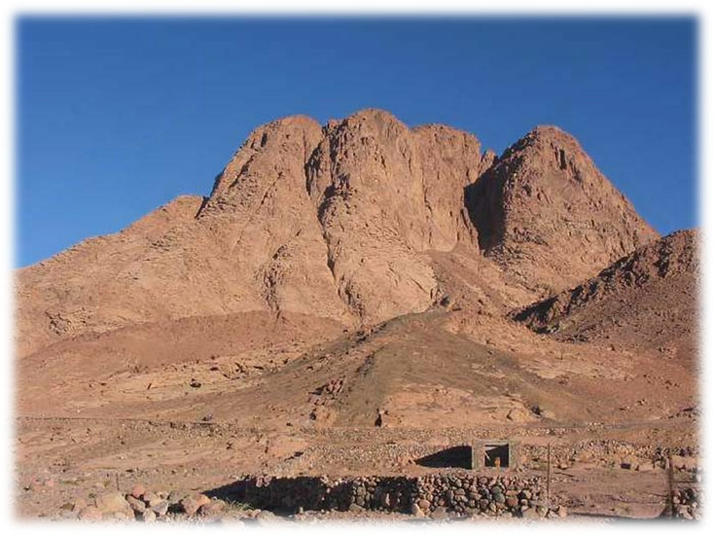
Numbers 21
21:4-5 “discouraged” (‘impatient’)
21:6 Wow !
21:7 Repentance
21:8-9 Hmmmmm…

Slide 7
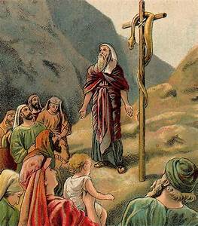
John 3
John 3:14-15 “And as Moses lifted up the serpent in the wilderness, even so must the Son of Man be lifted up, that whoever believes in Him should not perish but have eternal life”

Slide 8
John 3
John 3:3-5 “Jesus answered and said to him, Most assuredly, I say to you, unless one is born again, he cannot see the kingdom of God. Nicodemus said to Him, How can a man be born when he is old? Can he enter a second time into his mother’s womb and be born? Jesus answered, Most assuredly, I say to you, unless one is born of water and the Spirit, he cannot enter the kingdom of God”

Slide 9
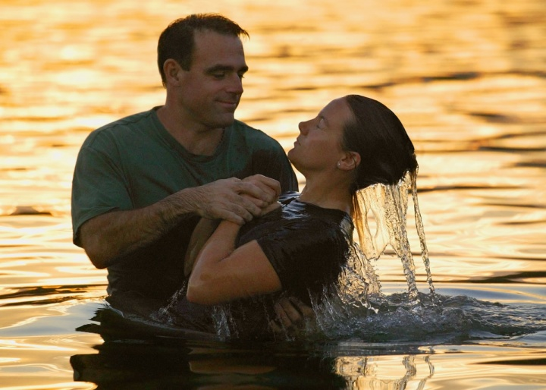
Acts 2:38 “Then Peter said to them, Repent, and let every one of you be baptized in the name of Jesus Christ for the remission of sins; and you shall receive the gift of the Holy Spirit”

Slide 11
It’s all about
Jesus
“All things were created through Him and for Him” Col. 1:16

