Slide 2
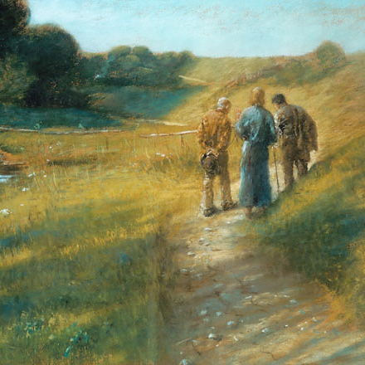
The Greatest Bible Study
You’ve Never Heard
We Have Jesus’ Materials
The OT is About Jesus
Preconceived Expectations

Slide 3
The Greatest Bible Study
You’ve Never Heard
From Failure to Total Victory
From Unbelief to Urgent Faith
From Grief to Unbelievable Joy

