Slide 2
God Still Raises the Dead

Slide 3
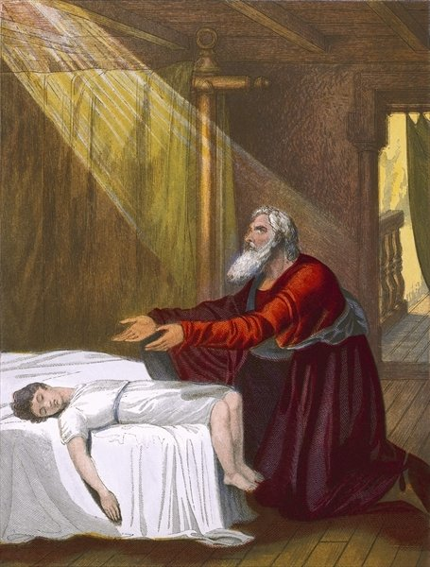
3 Old Testament Examples:
1 Kings 17:17-24 a widow’s son

Slide 4
1 Kings 17:21-23 “And he stretched himself out on the child three times, and cried out to the LORD and said, O LORD my God, I pray, let this child’s soul come back to him. Then the LORD heard the voice of Elijah; and the soul of the child came back to him, and he revived”
1 Kings 17:24 “Then the woman said to Elijah, Now by this I know that you are a man of God, and that the word of the LORD in your mouth is the truth”

Slide 5
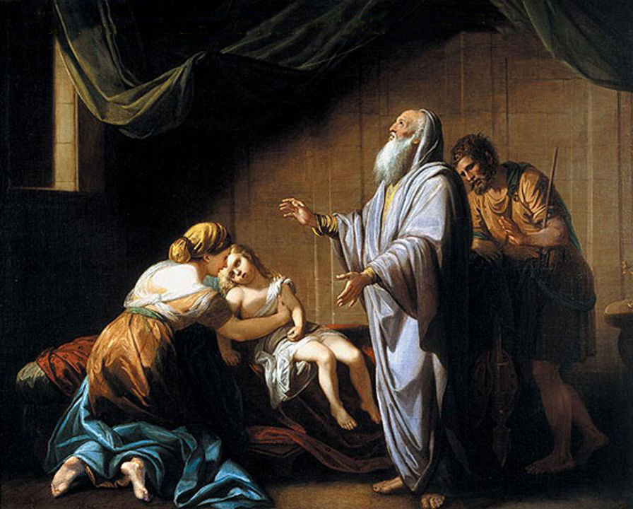
3 Old Testament Examples:
1 Kings 17:17-24 a widow’s son
2 Kings 4:18-37 a young boy

Slide 6
2 Kings 4:33-35 “He went in therefore, shut the door behind the two of them, and prayed to the LORD. And he went up and lay on the child, and put his mouth on his mouth, his eyes on his eyes, and his hands on his hands; and he stretched himself out on the child, and the flesh of the child became warm”

Slide 7
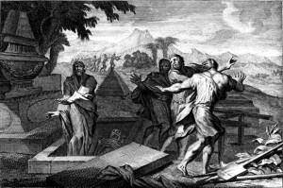
3 Old Testament Examples:
1 Kings 17:17-24 a widow’s son
2 Kings 4:18-37 a young boy
2 Kings 13:20-21 an unnamed man

Slide 8
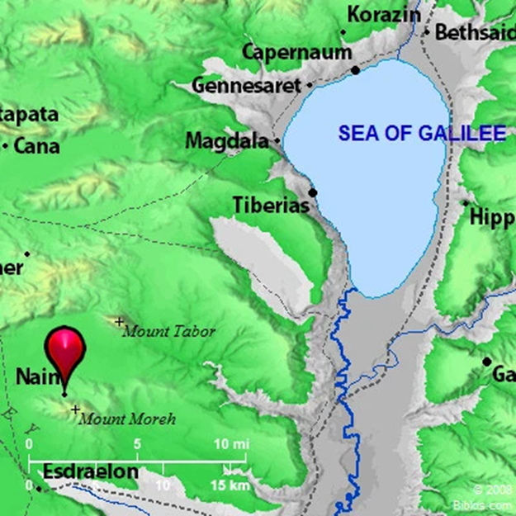
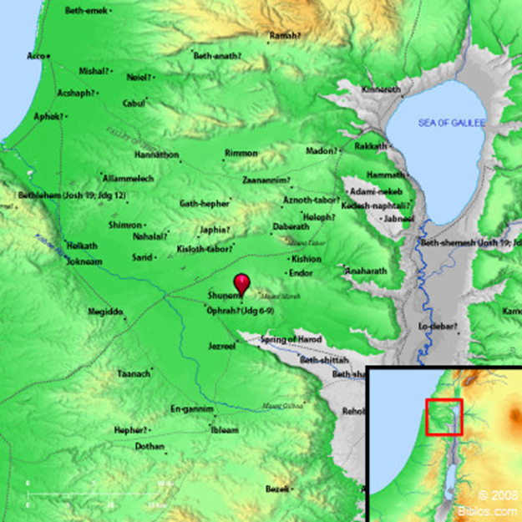
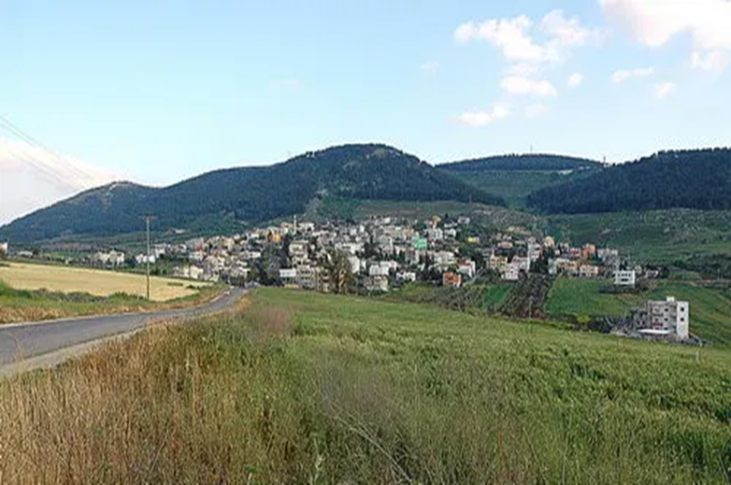
Luke 7:11-15
Nain

Slide 9
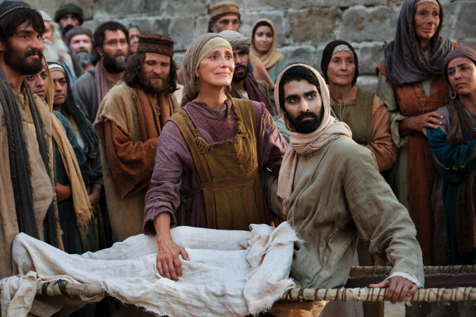
Luke 7:11-15
Nain
Funeral procession
Widow’s only son

Slide 10
John 2:11 “This beginning of signs Jesus did in Cana of Galilee, and manifested His glory; and His disciples believed in Him”
John 3:2 “This man came to Jesus by night and said to Him, Rabbi, we know that You are a teacher come from God; for no one can do these signs that You do unless God is with him”

Slide 11
John 20:30-31 “And truly Jesus did many other signs in the presence of His disciples, which are not written in this book; but these are written that you may believe that Jesus is the Christ, the Son of God, and that believing you may have life in His name”

Slide 12
Luke 7:11-15
Luke 7:16-17 “Then fear came upon all, and they glorified God, saying, ‘A great prophet has risen up among us’; and, ‘God has visited His people’. And this report about Him went throughout all Judea and all the surrounding region”

Slide 13
Deuteronomy 18:15 “The LORD your God will raise up for you a Prophet like me from your midst, from your brethren. Him you shall hear”
Acts 3:26 “To you first, God, having raised up His Servant Jesus, sent Him to bless you, in turning away every one of you from your iniquities”

Slide 14
God STILL Raises the Dead !
John 5:28-29 “Do not marvel at this; for the hour is coming in which all who are in the graves will hear His voice and come forth – those who have done good, to the resurrection of life, and those who have done evil, to the resurrection of condemnation”

Slide 15
God STILL Raises the Dead !
Ephesians 2:1-10
Romans 6:3-4 “Or do you not know that as many of us as were baptized into Christ Jesus were baptized into His death? Therefore we were buried with Him through baptism into death, that just as Christ was raised from the dead by the glory of the Father, even so we also should walk in newness of life”

Slide 16
Colossians 2:11-13 “In Him you were also circumcised with the circumcision made without hands, by putting off the body of the sins of the flesh, by the circumcision of Christ, buried with Him in baptism, in which you also were raised with Him through faith in the working of God, who raised Him from the dead. And you, being dead in your trespasses and the uncircumcision of your flesh, He has made alive together with Him, having forgiven you all trespasses”

