Slide 2
Jesus, Jesus, Jesus
How important is Jesus ?

Slide 3
John 5:16-18
John 10:29-33
Mark 14:60-62
John 8:17-19 John 14:6-11
Acts 4:12
How much do YOU want to KNOW about Jesus ?

Slide 5
J
E
S
U
S
Genesis 1:1 “GOD” (Elohim – plural)
Genesis 1:26-27 “let US make”
John 8:57-59 “I AM”
Colossians 1:15-17 the Creator

Slide 6
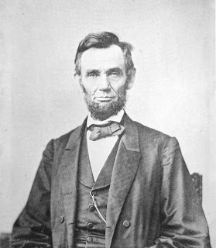
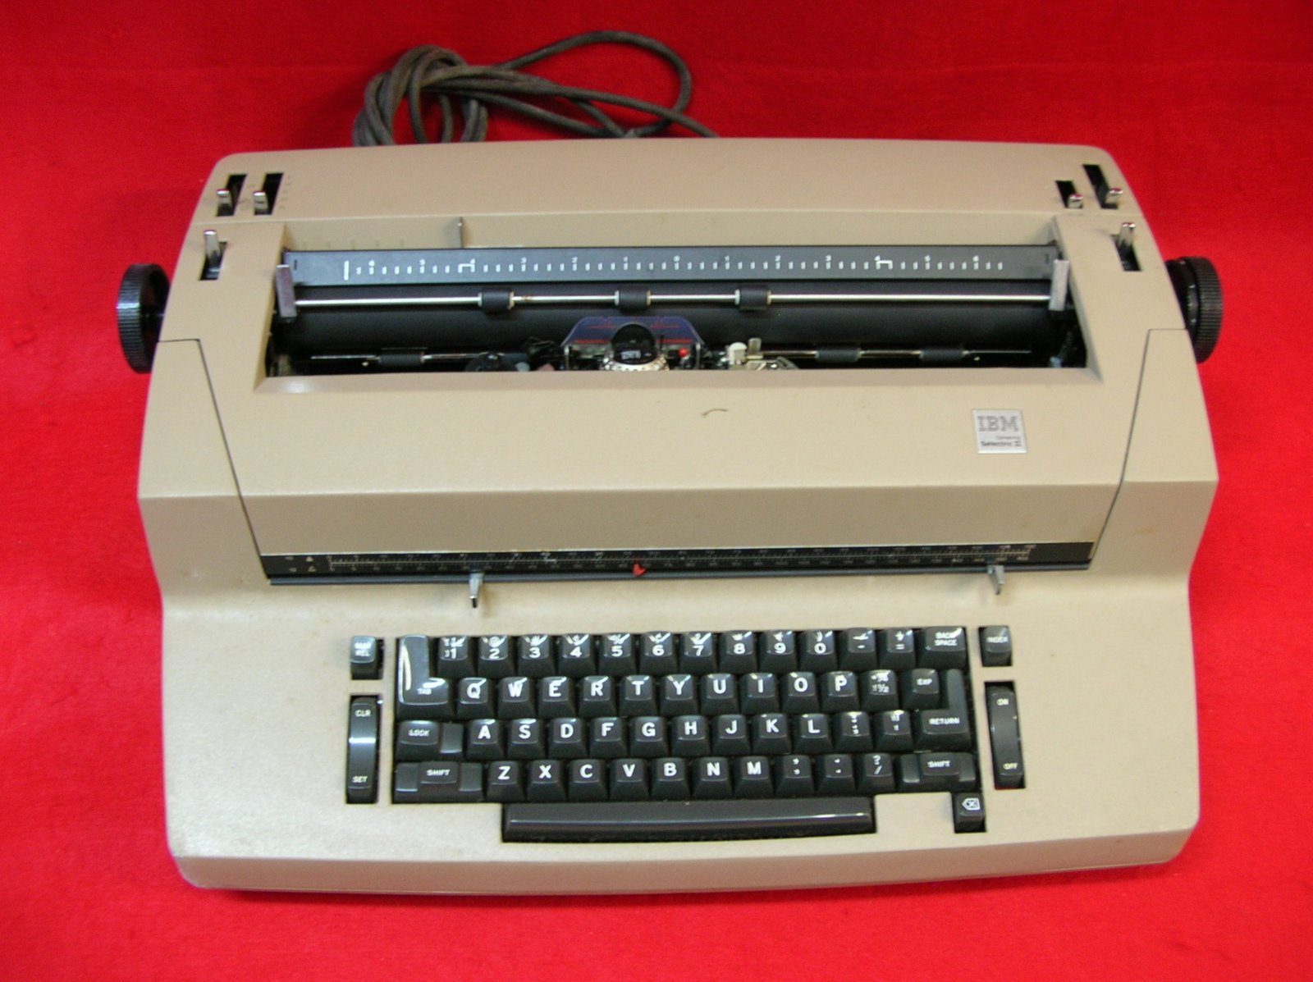
Shadow vs. Reality
Reality casts a Shadow
Copy / Original : ‘Type’ / ‘Antitype’

Slide 7
John 5:39-40, 45-46
“You search the scriptures, for in them you think you have eternal life; and these are they which testify of Me. But you are not willing to come to Me that you may have life”
“Do not think that I shall accuse you to the Father; there is one who accuses you – Moses, in whom you trust. For if you believed Moses, you would believe Me; for he wrote about Me”

Slide 9
Seeing JESUS
Adam
Moses
Jacob’s Ladder
Melchizadek
Lion’s den Angel
The Law (Word)
Jonah
Manna
Person in Furnace
Passover Lamb
Isaac
Ram
Abel’s Sacrifice
Stone in Dream
Covering Adams
Leader of Army
Boaz
Rock of Water
Sacrificial Blood
Grain Offerings
Samuel
David
Samson
The Veil

