Slide 2
NOMOPHOBIA

Slide 3
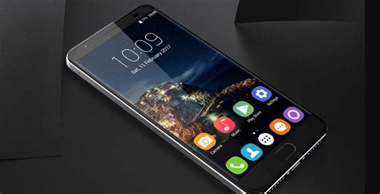
Statistics:
2,617x touches /day
150x unlocks /day
2 hr. 51 min. screentime
62x /day texting
40% night check
71% arm’s reach
85% check in conversation
75% carry everywhere
80% last / first

Slide 4
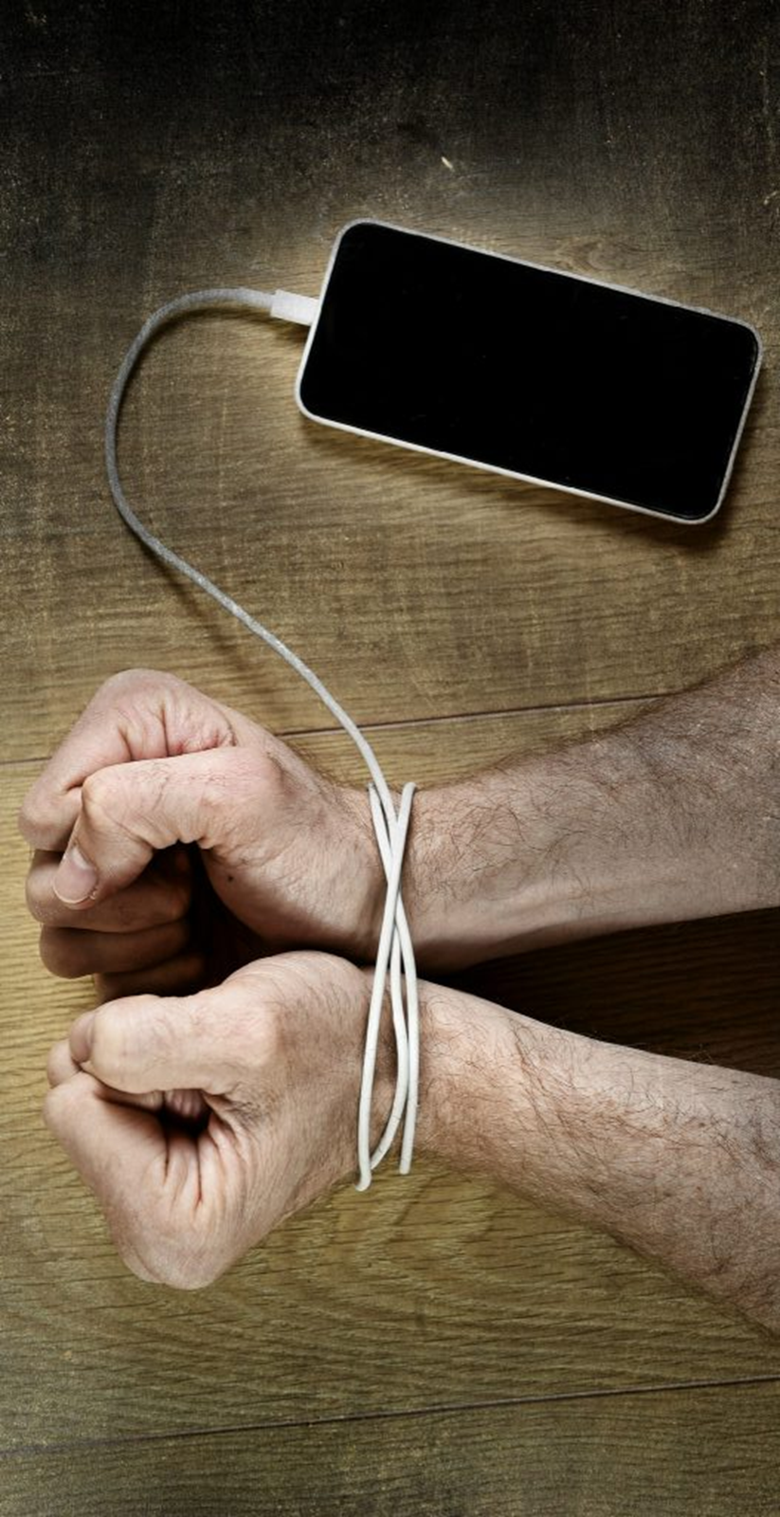
1 Corinthians 6:12-13 “All things are lawful for me, but all things are not profitable. All things are lawful for me, but I will not be brought under the power of any. Foods for the stomach and the stomach for foods, but God will destroy both it and them…”

Slide 5
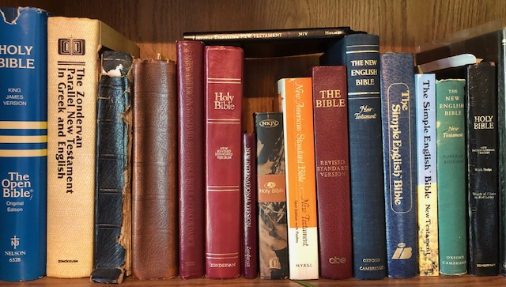
Romans 15:4 “For whatever things were written before were written for our learning, that we through the patience and comfort of the Scriptures might have hope”

Slide 6
Deuteronomy 6:6-9, 17-18 “And these words which I command you today shall be in your heart. You shall teach them diligently to your children, and shall talk of them when you sit in your house, when you walk by the way, when you lie down, and when you rise up. You shall bind them as a sign on your hand, and they shall be as frontlets between your eyes. You shall write them on the doorposts of your house and on your gates… You shall diligently keep the commandments of the LORD your God, His testimonies, and His statutes which He has commanded you. And you shall do what is right and good in the sight of the LORD, that it may be well with you, and that you may go in and possess the good land of which the LORD swore to your fathers”

Slide 7
Deuteronomy 17:18-20 “Also it shall be, when he sits on the throne of his kingdom, that he shall write for himself a copy of this law in a book, from the one before the priests, the Levites. And it shall be with him, and he shall read it all the days of his life, that he may learn to fear the LORD his God and be careful to observe all the words of this law and these statutes, that his heart may not be lifted above his brethren, that he may not turn aside from the commandment to the right hand or to the left, and that he may prolong his days in his kingdom, he and his children in the midst of Israel”

Slide 8
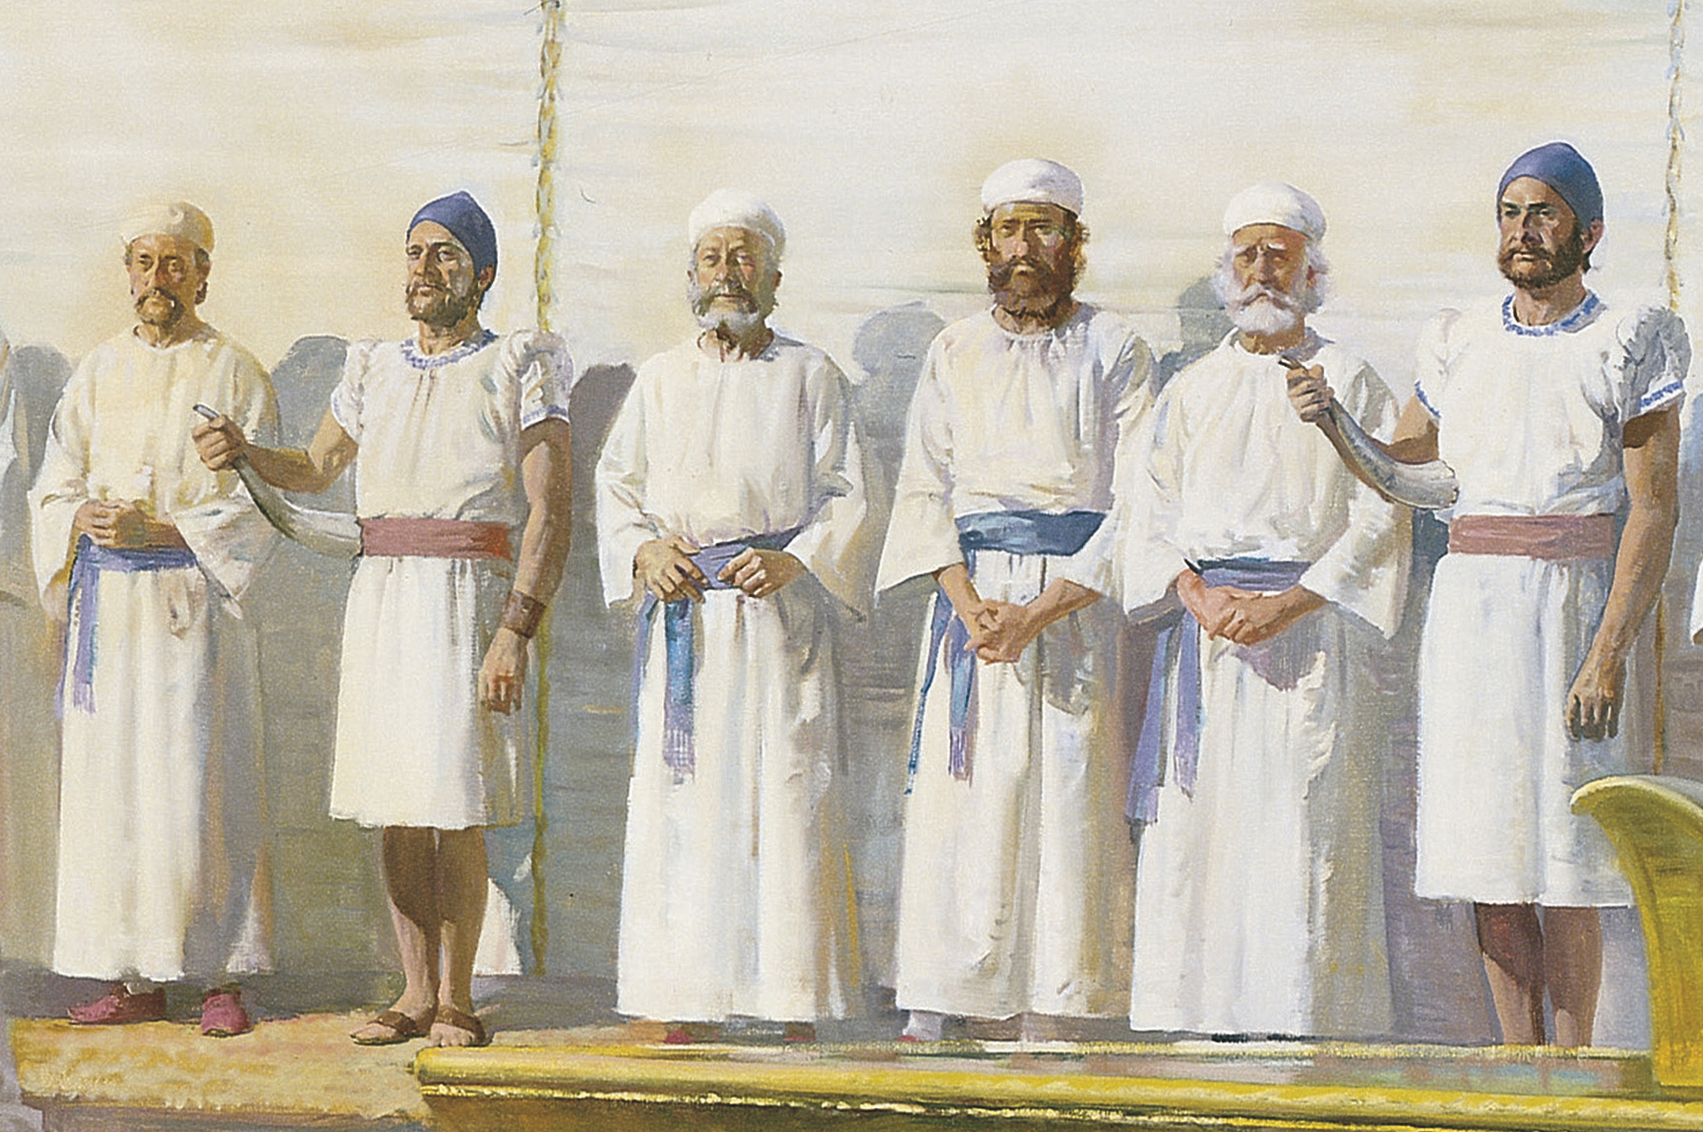
Deuteronomy 33:10 “They shall teach Jacob Your judgments, and Israel Your law. They shall put incense before You, and a whole burnt sacrifice on Your altar”

Slide 9
Matthew 22:29 “Jesus answered and said to them, You are mistaken, not knowing the scriptures nor the power of God”

Slide 10
Hebrews 4:12 “For the word of God is living and powerful, and sharper than any two-edged sword, piercing even to the division of soul and spirit, and of joints and marrow, and is a discerner of the thoughts and intents of the heart”
2 Timothy 3:16-17 “All scripture is given by inspiration of God, and is profitable for doctrine, for reproof, for correction, for instruction in righteousness, that the man of God may be complete, thoroughly equipped for every good work”

Slide 11
________________ =
?
‘the fear of being without your Bible or being able to use it’

Slide 12
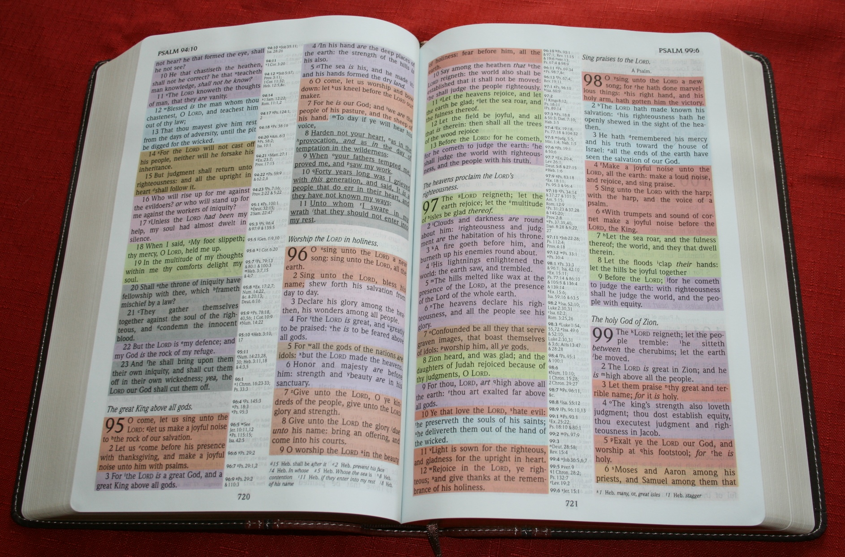
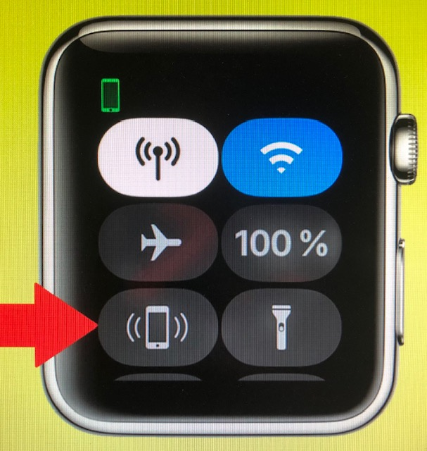
Statistics:
2,617x touches /day
150x unlocks /day
2 hr. 51 min. screentime
62x /day texting
40% night check
71% arm’s reach
85% check in conversation
75% carry everywhere
80% last / first
___x touches /day
___ hr. ___ min. pagetime
Check ___x /day for msgs
___% night check
Find my Bible
___% kids must have
___% carry everywhere
___% constant learning

Slide 13
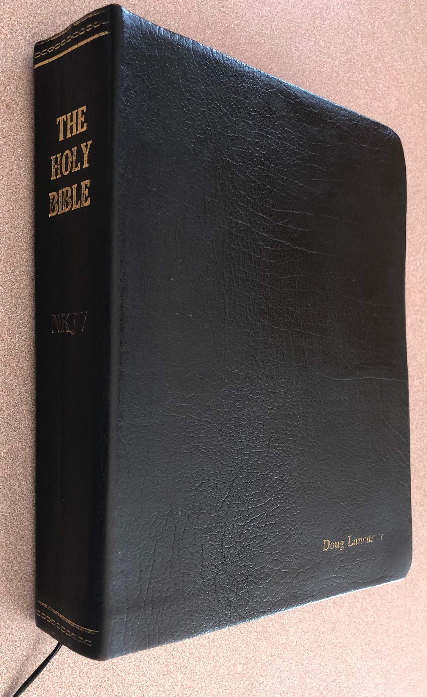
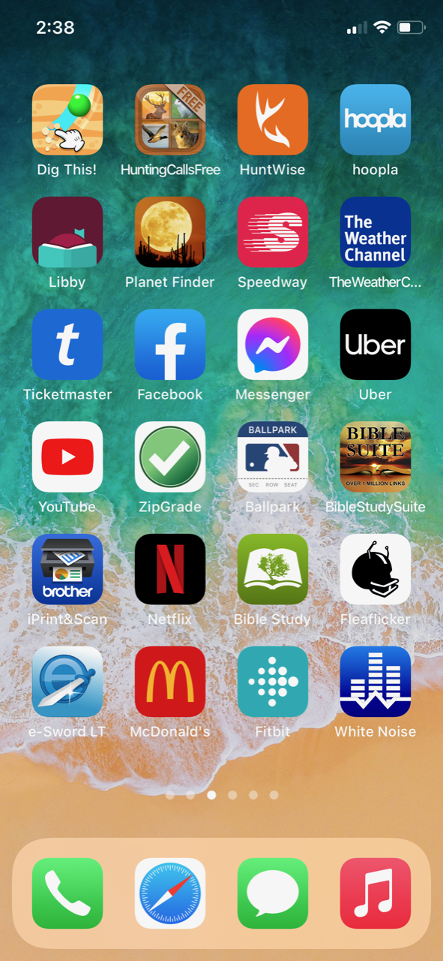
“But He said, More than that, blessed are those who hear the word of God and keep it!”
Luke 11:28

