Slide 2
TO FELLOWSHIP ACTS 2:42-47

Slide 3
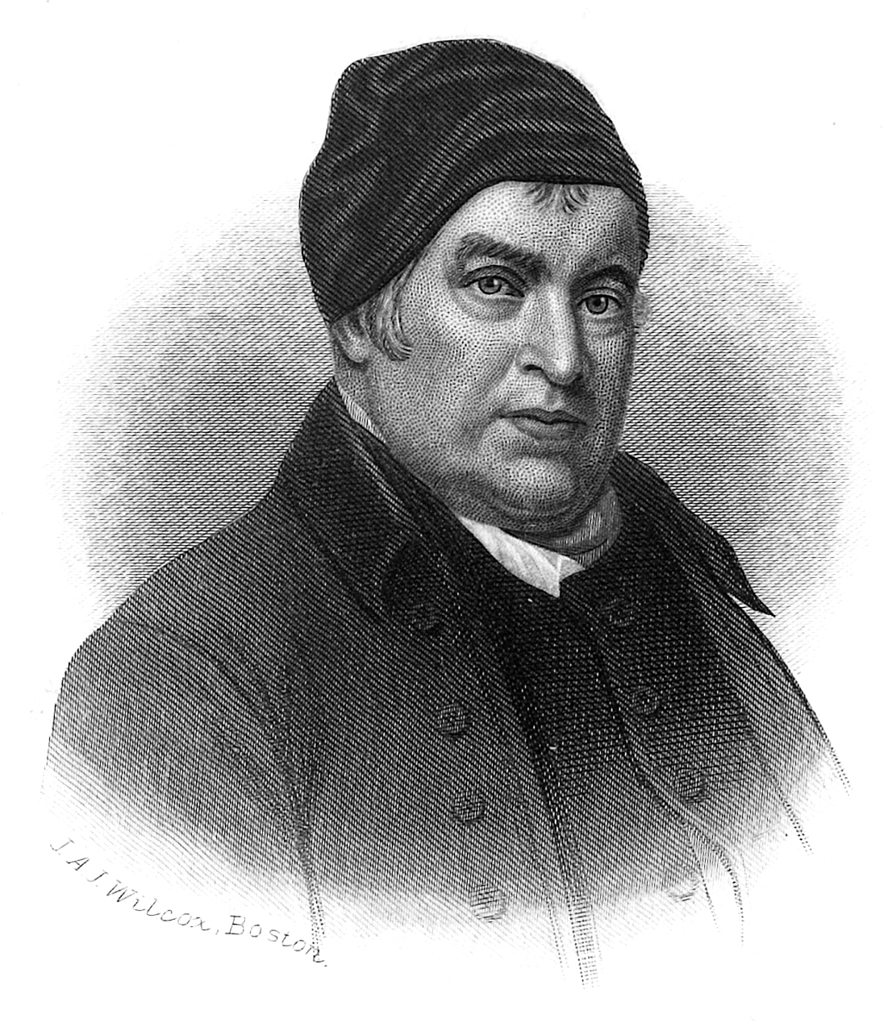
“Blest Be the Tie”
The communion of saints, bound together in love (st. 1),
United in worship (st. 2),
Sharing each other's burdens (st. 3),
Encouraging each other with the hope of eternal life in glory, where we will be reunited with departed friends and freed "from sorrow, toil, and pain and sin (st. 4-6).
John Fawcett

Slide 4
“they devoted themselves to.”

Slide 5
That to which you are devoted consumes your attention, your energy, your time, and even your finances.

Slide 6
“And they devoted themselves to the apostles' teaching and the fellowship, to the breaking of bread and the prayers. And awe came upon every soul, and many wonders and signs were being done through the apostles. And all who believed were together and had all things in common. And they were selling their possessions and belongings and distributing the proceeds to all, as any had need. And day by day, attending the temple together and breaking bread in their homes, they received their food with glad and generous hearts, praising God and having favor with all the people. And the Lord added to their number day by day those who were being saved.”
– Acts 2:42-47

Slide 7
what do you think about when you hear the term “fellowship”?

Slide 8
The Greek word translated fellowship refers to an “association, community, communion, [or] joint participation.”

Slide 9
fellowship is A partnership between multiple parties
“extending the right hand of fellowship”
– Galatians 2:9

Slide 10
fellowship is A partnership between multiple parties
“not be unequally yoked with unbelievers.”
– 2 Corinthians 6:14

Slide 11
“converts who remained active in a church longer than six months developed an average of seven friends in their church, but converts who dropped out before six months only developed two friends.”
– Dr. Flavil Yeakley

Slide 12
“a church that focuses on helping new converts make friends within the church will be more likely to grow.”
– Dr. Flavil Yeakley

Slide 13
The problem today is that all too often many do not recognize fellowship as an essential part of our assemblies.

Slide 14
Scripture places a higher priority on fellowship.

Slide 15
CAN YOU PRAISE God ALONE?
CAN YOU PRAY ALONE?
CAN YOU STUDY ALONE?
CAN YOU CONTRIBUTE ALONE?

Slide 16
CAN YOU fellowship ALONE?
“let us consider how to stir up one another to love and good works, not neglecting to meet together, as is the habit of some, but encouraging one another, and all the more as you see the Day drawing near”
– Hebrews 10:24-25

Slide 17
Why should we exhort daily?
“But exhort one another every day, as long as it is called “today,” that none of you may be hardened by the deceitfulness of sin.”
– Hebrews 3:13

Slide 18
God’s will is for us to fellowship with the believers, not just to be present with the believers.

