Slide 2
YIELDING OUR ATTITUDES

Slide 3
“An evil and adulterous generation craves for a sign; and yet no sign will be to it but the sign of Jonah the prophet; for just given as Jonah was three days and three nights in the belly of the sea monster, so will the Son of Man be three days and three nights in the heart of the earth. – Matthew 12:39-40

Slide 4
WHO WAS JONAH AND
WHAT IS THE BOOK ABOUT?
Jonah was a prophet of God who ministered to the nation of Israel and other nations around the 8th C. BC.

Slide 5
WHO WAS JONAH AND
WHAT IS THE BOOK ABOUT?
The book of Jonah can be summed up like this:
God told the prophet Jonah to go and preach against the great city of Nineveh.
Within 50 years, Nineveh would become the capital of the vast Assyrian empire.
Within a few years, the Assyrians would eventually conquer the Northern Kingdom of God known as Israel.

Slide 6
WHO WAS JONAH AND
WHAT IS THE BOOK ABOUT?
Several years before Assyria conquered Israel, God sent Jonah to Nineveh to preach against its wickedness.

Slide 7
We must have a yielding
attitude towards god’s will
The word of the Lord came to Jonah the son of Amittai saying, “Arise, go to Nineveh the great city and cry against it, for their wickedness has come up before Me.” But Jonah rose up to flee to Tarshish from the presence of the Lord. So he went down to Joppa, found a ship which was going to Tarshish, paid the fare and went down into it to go with them to Tarshish from the presence of the Lord. –Jonah 1:1-3

Slide 8
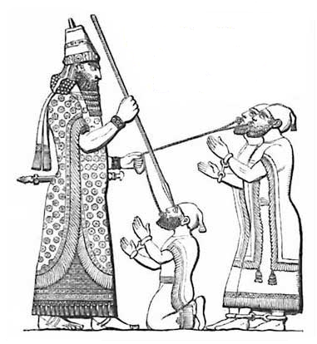
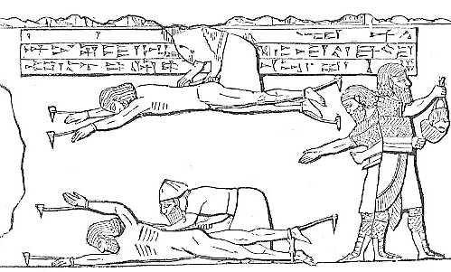
Bas-Reliefs Showing Assyrians
Torturing Prisoners
Leading Captives by Lip-Rings and Blinding Eyes
Assyrians Flaying Prisoners

Slide 9
We must have a yielding
attitude towards god’s will
BECAUSE JONAH DISOBEYED GOD HIS LIFE BEGAN TO FALL APART
Israelites Disobedience—40 years wandering
David’s Disobedience—Death child and family problems
What about our yielding to God’s will?

Slide 10
We must have a yielding
attitude towards god’s will
YIELDING TO GOD’S WORD
BRINGS ABOUT SALVATION
“Not everyone who says to Me, ‘Lord, Lord,’ will enter the kingdom of heaven, but he who does the will of My Father who is in heaven will enter.” –Matthew 7:21
“My mother and My brothers are these who hear the word of God and do it.” –Luke 8:21

Slide 11
We must have a yielding
attitude towards god’s will
When We Yield To God’s Word, Then
Our Lives Will Flourish
But one who looks intently at the perfect law, the law of liberty, and abides by it, not having become a forgetful hearer but an effectual doer, this man will be blessed in what he does.–James 1:25

Slide 12
We must have a yielding
attitude towards god’s will
When We Yield To God’s Word, Then
Our Lives Will Flourish
This book of the law shall not depart from your mouth, but you shall meditate on it day and night, so that you may be careful to do according to all that is written in it; for then you will make your way prosperous, and then you will have success.–Joshua 1:8

Slide 13
What Must I Do To Be Saved?
Hear and Learn – Rom. 10:17; John 6:45; 17:3
Believe – Heb. 11:6; John 6:29; 8:24
Confess the Lord – Matt. 10:32-33; Rom. 10:9-10
Repent – Luke 13:3; Acts 3:19; 17:30
Be Baptized – Mark 16:16; Acts 22:16; Gal. 3:26-27; 1 Pet. 3:21
Be Faithful Unto Death – Revelation 2:10

