Slide 1
Deuteronomy
A survey Of the Scriptures

Slide 2
Class Schedule
Lesson 1: Introduction, Chapters 1 & 2
Lesson 2: Chapters 3-5
Lesson 3: Chapters 6-9
Lesson 4: Chapters 10-12
Lesson 5: Chapters 13-15
Lesson 6: Chapters 16-18
Lesson 7: Chapters 19-21
Lesson 8: Chapters 22-25
Lesson 9: Chapters 26-28
Lesson 10: Chapters 29-34

Slide 3
Deuteronomy Break Down
Israel's Past Reviewed | Exposition of the Law |  |  | Mosaic Covenant | Moses Final Words and Death
 | Chapters 4:44-11
 | Ceremional Laws | Civil Laws | Social Laws
Chapters 1-4:43 | Chapters 12-16:17 | Chapters 16:18-21 | Chapters 22-26 | Chapters 27-30 | Chapters 31-34
PAST- What God has done. | PRESENT - What God expects of Israel |  |  | FUTURE - What God will do for Israel

Slide 4
Why Study Deuteronomy?
It’s a book about the Grace of God.
It gives us a clear understanding of the rest of the Old Testament.
There aren’t many differences between the children of God then (Israelites) and today (Christians)

Slide 5
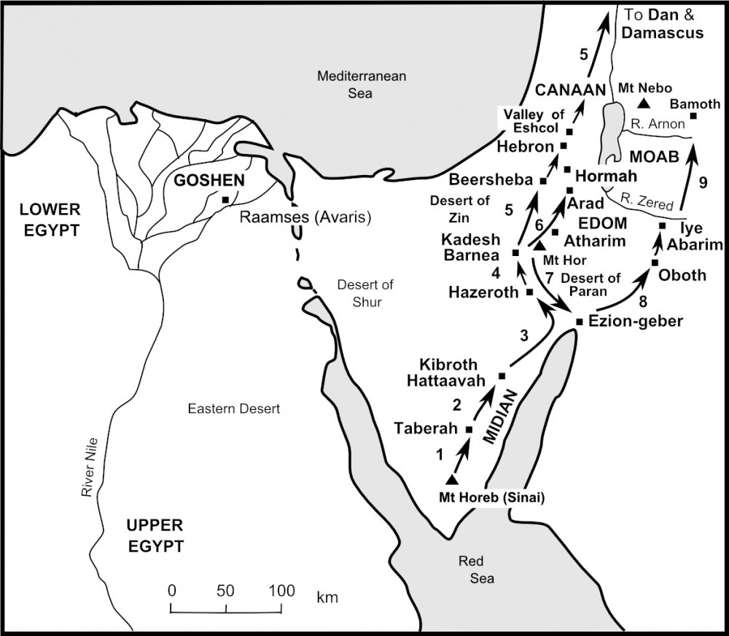

Slide 6
Chapter 1 & 2 discussion
The conquest of the kingdom of Sihon 2:24-37
Moses emphasizes an important thought in vv25,29,30,31,33,and 36?

Slide 7
Chapter 1 & 2 discussion
The conquest of the kingdom of Sihon 2:24-37
Moses emphasizes an important thought in vv25,29,30,31,33,and 36?
God’s Faithfulness

Slide 8
Chapter 1 & 2 discussion
Who or what are the Rephaim (2:11 and 3:11)?

Slide 9
Chapter 1 & 2 discussion
Who or what are the Rephaim (2:11 and 3:11)?
The Hebrew word Rephaim has two distinct meanings:
The First, “departed spirits whose dwelling place was Sheol.”
The Second “the terrible ones.”

Slide 10
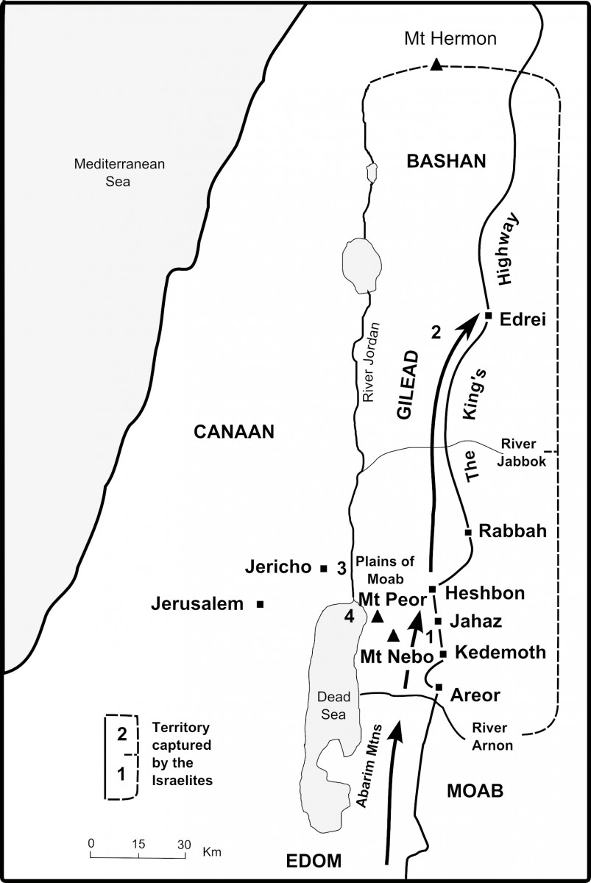

Slide 11
Chapter 3 discussion
What command did God give to the Israelites in verse 2?
How do we compare verse 3:2 with 2:31 and 2:25?
How does Psalms 2:1-4 compare to the verses just discussed?
Why is the size of Og’s bed or casket important?
Numbers 13:31-14:4
Do we see any resemblance to Christians today?

Slide 12
Chapter 3 discussion
The destruction of King Sihon and Og’s territories brings a question to many minds. Deuteronomy 2:33 and 3:6.
Why does God allow the killing of children?
Job 1:21 Genesis 4:10 1 Samuel 28:15-19 Matthew 27:50-53
Death is only our judgement not the end

Slide 13
Chapter 3 discussion
What happens to the two kingdoms?
What was the command given to the Reubenites, Gadites, and the half-tribe of Manasseh?

Slide 14
Chapter 4 discussion
• What was Moses going to be teaching them about (verse 1)?
• What is the theme of the first fourteen verses of this chapter?
• What would be the results of obedience?

Slide 15
Chapter 4 discussion
• What were the results of disobedience?
• How could they “take care to keep their soul diligently?”
• How can we do that today?

Slide 16
Chapter 4 discussion
• What responsibility did they have toward the next generation?
• Who are we fighting with for the souls of our children?
• What advice would you give a new parent regarding teaching his children the things of God?
• What did the fire surrounding God represent? The darkness?

