Slide 2
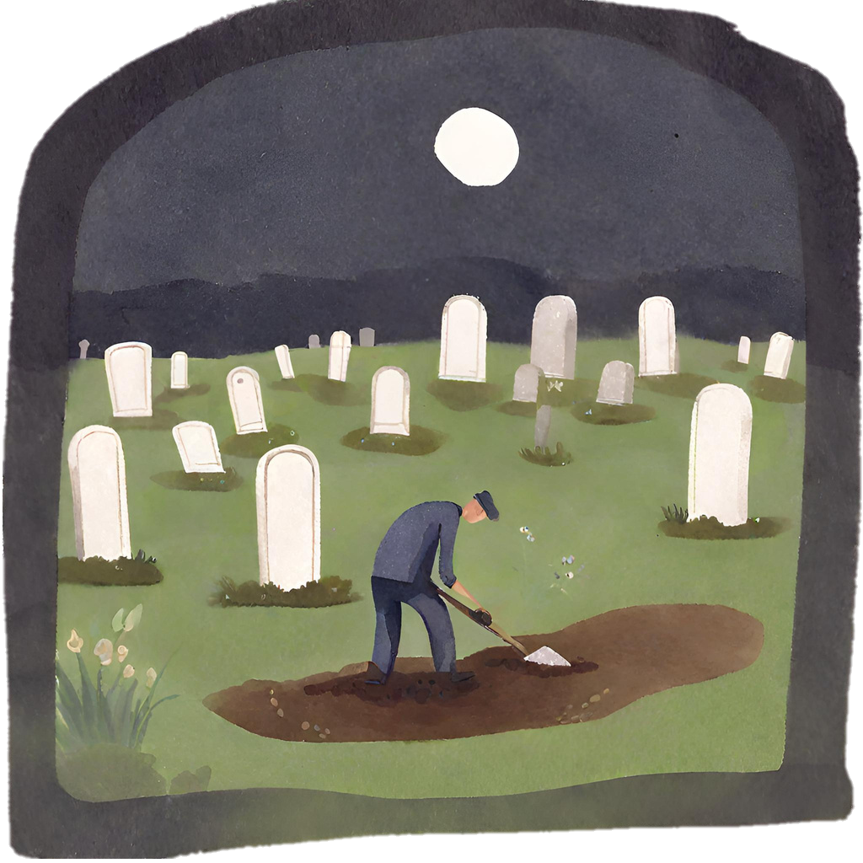
Are You
Digging Up
The Old Man?
Examining
Our Ways:

Slide 3
We Have Put To Death the Old Man
When we are baptized in Christ, we put to death the old man
(Rom. 6:1-13)

Slide 4
Romans 6:1-13
What shall we say then? Shall we continue in sin that grace may abound? Certainly not! How shall we who died to sin live any longer in it? Or do you not know that as many of us as were baptized into Christ Jesus were baptized into His death? Therefore we were buried with Him through baptism into death, that just as Christ was raised from the dead by the glory of the Father, even so we also should walk in newness of life. For if we have been united together in the likeness of His death, certainly we also shall be in the likeness of His resurrection, knowing this, that our old man was crucified with Him, that the body of sin might be done away with, that we should no longer be slaves of sin. For he who has died has been freed from sin…

Slide 5
Romans 6:1-13
Now if we died with Christ, we believe that we shall also live with Him, knowing that Christ, having been raised from the dead, dies no more. Death no longer has dominion over Him. For the death that He died, He died to sin once for all; but the life that He lives, He lives to God. Likewise you also, reckon yourselves to be dead indeed to sin, but alive to God in Christ Jesus our Lord. Therefore do not let sin reign in your mortal body, that you should obey it in its lusts. And do not present your members as instruments of unrighteousness to sin, but present yourselves to God as being alive from the dead, and your members as instruments of righteousness to God.

Slide 6
We Have Put To Death the Old Man
When we are baptized in Christ, we put to death the old man
(Rom. 6:1-13)
We put off our former conduct & the old man corrupt with deceitful lusts; put on the new man in true righteousness and holiness. (Eph. 4:17-24)

Slide 7
Ephesians 4:17-24
This I say, therefore, and testify in the Lord, that you should no longer walk as the rest of the Gentiles walk, in the futility of their mind, having their understanding darkened, being alienated from the life of God, because of the ignorance that is in them, because of the blindness of their heart; who, being past feeling, have given themselves over to lewdness, to work all uncleanness with greediness. But you have not so learned Christ, if indeed you have heard Him and have been taught by Him, as the truth is in Jesus: that you put off, concerning your former conduct, the old man which grows corrupt according to the deceitful lusts, and be renewed in the spirit of your mind, and that you put on the new man which was created according to God, in true righteousness and holiness.

Slide 8
We Have Put To Death the Old Man
When we are baptized in Christ, we put to death the old man
(Rom. 6:1-13)
We put off our former conduct & the old man corrupt with deceitful lusts; put on the new man in true righteousness and holiness. (Eph. 4:17-24)
We have put to death the old man with his deeds
  Col. 3:5-11

Slide 9
Colossians 3:5-11
Therefore put to death your members which are on the earth: fornication, uncleanness, passion, evil desire, and covetousness, which is idolatry. Because of these things the wrath of God is coming upon the sons of disobedience, in which you yourselves once walked when you lived in them.
But now you yourselves are to put off all these: anger, wrath, malice, blasphemy, filthy language out of your mouth. Do not lie to one another, since you have put off the old man with his deeds, and have put on the new man who is renewed in knowledge according to the image of Him who created him, where there is neither Greek nor Jew, circumcised nor uncircumcised, barbarian, Scythian, slave nor free, but Christ is all and in all.

Slide 10
We Have Put To Death the Old Man
Fornication
Uncleanness
Passion
Evil Desire
Covetousness
Anger
Wrath
Malice
Blasphemy
Filthy language
Lying
Notes:
Fornication (porneia): including (but not limited to) adultery, premarital sex, homosexuality, bestiality, incest, and prostitution
Uncleanness: moral impurity, pursuit of sensuality, the impurity of lustful, luxurious, profligate living
Passion: depraved, inordinate affection/lusts, inc. pornography
Evil Desire – strong urges for evil, esp. in a sexual way
Covetousness, greed – desire for worldly things, putting material things before God (idolatry)
Anger - movement or agitation of the soul, impulse, desire, violent emotion
Wrath - passion, heat, anger forthwith boiling up and soon subsiding again
Malice - malignity, ill-will, desire to injure; wickedness, depravity
Blasphemy - slander, detraction, speech injurious to another’s good name
Filthy language - foul speaking, low and obscene speech, dirty jokes
Lying - to speak deliberate falsehoods; to deceive one by a lie

Slide 11
We Have Put To Death the Old Man
When we are baptized in Christ, we put to death the old man
(Rom. 6:1-13)
We put off our former conduct & the old man corrupt with deceitful lusts; put on the new man in true righteousness and holiness. (Eph. 4:17-24)
We have put to death the old man with his deeds
  Col. 3:5-11
  Gal. 5:16-21

Slide 12
Galatians 5:16-21
I say then: Walk in the Spirit, and you shall not fulfill the lust of the flesh. For the flesh lusts against the Spirit, and the Spirit against the flesh; and these are contrary to one another, so that you do not do the things that you wish. But if you are led by the Spirit, you are not under the law. Now the works of the flesh are evident, which are: adultery, fornication, uncleanness, lewdness, idolatry, sorcery, hatred, contentions, jealousies, outbursts of wrath, selfish ambitions, dissensions, heresies, envy, murders, drunkenness, revelries, and the like; of which I tell you beforehand, just as I also told you in time past, that those who practice such things will not inherit the kingdom of God.

Slide 13
We Have Put To Death the Old Man
Adultery/Fornication
Uncleanness
Lewdness
Idolatry
Sorcery
Contentions
Jealousies
Outbursts of wrath
Selfish ambitions
Dissensions
Heresies
Envy
Murders
Drunkenness/Revelries
And the like
Notes:
Adultery/Fornication: Unfaithfulness in marriage as well as the wider variety of sexual sins that include incest, homosexuality and sexual lust
Uncleanness: things that were dirty, impure, coarse or vulgar esp. in sexuality
Lewdness: wanton acts or manners, as ﬁlthy words, indecent bodily movements, unchaste handling of males and females, etc. including immodest dress, mixed swimming, dancing, dirty talk and jokes
Idolatry: worshipping something or someone other than the true God.
Sorcery: not wizards & wands: drug use, any drug to manipulate one’s state of consciousness Hatred: Enmity/hatred/fierce opposition
Contentions: strife, variance, to be at odds, to quarrel over things
Jealousies: feeling of anger and disappointment at someone else’s success or good fortune
Outbursts of wrath: hot-tempered

Slide 14
We Have Put To Death the Old Man
When we are baptized in Christ, we put to death the old man
(Rom. 6:1-13)
We put off our former conduct & the old man corrupt with deceitful lusts; put on the new man in true righteousness and holiness. (Eph. 4:17-24)
We have put to death the old man with his deeds
  Col. 3:5-11
  Gal. 5:16-21
  1 Pet. 4:1-5

Slide 15
1 Peter 4:1-5
Therefore, since Christ suffered for us in the flesh, arm yourselves also with the same mind, for he who has suffered in the flesh has ceased from sin, that he no longer should live the rest of his time in the flesh for the lusts of men, but for the will of God. For we have spent enough of our past lifetime in doing the will of the Gentiles—when we walked in lewdness, lusts, drunkenness, revelries, drinking parties, and abominable idolatries. In regard to these, they think it strange that you do not run with them in the same flood of dissipation, speaking evil of you. They will give an account to Him who is ready to judge the living and the dead.

Slide 16
We Have Put To Death the Old Man
Again with the lewdness, lusts, and idolatries as we have seen in the previous lists but Peter lists out:
  Drunkenness – passed out drunk in the ditch or gutter
  Revelries – drunken orgies, keggers, frat parties
  Drinking parties – Cocktail hour, social drinking with the coworkers after work

Slide 17
We Have Put On the New Man
Put on new man and his righteousness:
  Col. 3:12-17: Tender mercies, kindness, humility, meekness, longsuffering; bearing with one another, and forgiving one another, love

Slide 18
Colossians 3:12-17
Therefore, as the elect of God, holy and beloved, put on tender mercies, kindness, humility, meekness, longsuffering; bearing with one another, and forgiving one another, if anyone has a complaint against another; even as Christ forgave you, so you also must do. But above all these things put on love, which is the bond of perfection. And let the peace of God rule in your hearts, to which also you were called in one body; and be thankful. Let the word of Christ dwell in you richly in all wisdom, teaching and admonishing one another in psalms and hymns and spiritual songs, singing with grace in your hearts to the Lord. And whatever you do in word or deed, do all in the name of the Lord Jesus, giving thanks to God the Father through Him.

Slide 19
We Have Put On the New Man
Put on new man and his righteousness:
  Col. 3:12-17: Tender mercies, kindness, humility, meekness, longsuffering; bearing with one another, and forgiving one another, love
  Gal. 5:22-26: love, joy, peace, longsuffering, kindness, goodness, faithfulness, gentleness, self-control.

Slide 20
Galatians 5:22-26
But the fruit of the Spirit is love, joy, peace, longsuffering, kindness, goodness, faithfulness, gentleness, self-control. Against such there is no law. And those who are Christ’s have crucified the flesh with its passions and desires. If we live in the Spirit, let us also walk in the Spirit. Let us not become conceited, provoking one another, envying one another.

Slide 21
We Have Put On the New Man
Put on new man and his righteousness:
  Col. 3:12-17: Tender mercies, kindness, humility, meekness, longsuffering; bearing with one another, and forgiving one another, love
  Gal. 5:22-26: love, joy, peace, longsuffering, kindness, goodness, faithfulness, gentleness, self-control.
  Eph. 4:1-3: Walk worthy of our calling, with all lowliness and gentleness, with longsuffering, bearing with one another in love, endeavoring to keep the unity of the Spirit in the bond of peace.

Slide 22
Ephesians 4:1-3
I, therefore, the prisoner of the Lord, beseech you to walk worthy of the calling with which you were called, with all lowliness and gentleness, with longsuffering, bearing with one another in love, endeavoring to keep the unity of the Spirit in the bond of peace.

Slide 23
We Have Put On the New Man
Do Others See Christ When They See Us?
  We are Christians (Acts 11:26) – lit. Christ-like

Slide 24
Acts 11:26
And when he had found him, he brought him to Antioch. So it was that for a whole year they assembled with the church and taught a great many people. And the disciples were first called Christians in Antioch.

Slide 25
We Have Put On the New Man
Do Others See Christ When They See Us?
  We are Christians (Acts 11:26) – lit. Christ-like
  Christ lives in me. (Gal. 2:20)

Slide 26
Galatians 2:20
I have been crucified with Christ; it is no longer I who live, but Christ lives in me; and the life which I now live in the flesh I live by faith in the Son of God, who loved me and gave Himself for me.

Slide 27
We Have Put On the New Man
Do Others See Christ When They See Us?
  We are Christians (Acts 11:26) – lit. Christ-like
  Christ lives in me. (Gal. 2:20)
  We have put on/clothed ourselves with Christ (Gal. 3:27)

Slide 28
Galatians 3:27
For as many of you as were baptized into Christ have put on Christ.
For all of you who were baptized into Christ have clothed yourselves with Christ. (NASB)

Slide 29
Case Study: Simon the Sorcerer
He used to be a sorcerer and astonish/trick people of Samaria (Acts 8:9-13)

Slide 30
Acts 8:9-13
But there was a certain man called Simon, who previously practiced sorcery in the city and astonished the people of Samaria, claiming that he was someone great, to whom they all gave heed, from the least to the greatest, saying, “This man is the great power of God.” And they heeded him because he had astonished them with his sorceries for a long time. But when they believed Philip as he preached the things concerning the kingdom of God and the name of Jesus Christ, both men and women were baptized. Then Simon himself also believed; and when he was baptized he continued with Philip, and was amazed, seeing the miracles and signs which were done.

Slide 31
Case Study: Simon the Sorcerer
He used to be a sorcerer and astonish/trick people of Samaria (Acts 8:9-13)
He believed and was baptized (cf. Mark 16:15-16)

Slide 32
Mark 16:15-16
And He said to them, “Go into all the world and preach the gospel to every creature. He who believes and is baptized will be saved; but he who does not believe will be condemned.

Slide 33
Case Study: Simon the Sorcerer
He used to be a sorcerer and astonish/trick people of Samaria (Acts 8:9-13)
He believed and was baptized (cf. Mark 16:15-16)
Simon dug up his old man and tried to buy the power of the Holy Spirit. (Acts 8:14-19)

Slide 34
Acts 8:14-19
Now when the apostles who were at Jerusalem heard that Samaria had received the word of God, they sent Peter and John to them, who, when they had come down, prayed for them that they might receive the Holy Spirit. For as yet He had fallen upon none of them. They had only been baptized in the name of the Lord Jesus. Then they laid hands on them, and they received the Holy Spirit. And when Simon saw that through the laying on of the apostles’ hands the Holy Spirit was given, he offered them money, saying, “Give me this power also, that anyone on whom I lay hands may receive the Holy Spirit.”

Slide 35
Case Study: Simon the Sorcerer
He used to be a sorcerer and astonish/trick people of Samaria (Acts 8:9-13)
He believed and was baptized (cf. Mark 16:15-16)
Simon dug up his old man and tried to buy the power of the Holy Spirit. (Acts 8:14-19)
Peter commands Simon to repent (Acts 8:20-24)

Slide 36
Acts 8:20-24
But Peter said to him, “Your money perish with you, because you thought that the gift of God could be purchased with money! You have neither part nor portion in this matter, for your heart is not right in the sight of God. Repent therefore of this your wickedness, and pray God if perhaps the thought of your heart may be forgiven you. For I see that you are poisoned by bitterness and bound by iniquity.” Then Simon answered and said, “Pray to the Lord for me, that none of the things which you have spoken may come upon me.”

Slide 37
Application
Have you buried the old man in baptism?
Have we let them old man with his deeds stay buried or have we dug him up in our:
  Sexual Sins: Adultery, Fornication, Uncleanness, Passion, Evil Desire, Lewdness, Lusts
  Personal Goals: Covetousness, Selfish Ambition
  Treatment Of Others: Anger, Wrath, Malice, Blasphemy, Filthy Language, Lying, Hatred, Contentions, Jealousies, Outbursts Of Wrath, Dissensions, Heresies, Envy, Murders, Drunkenness, Revelries, Drinking Parties
  And The Like
Paul’s affirmation to the Romans holds true today (Rom. 13:11-14)

Slide 38
Romans 13:11-14
And do this, knowing the time, that now it is high time to awake out of sleep; for now our salvation is nearer than when we first believed. The night is far spent, the day is at hand. Therefore let us cast off the works of darkness, and let us put on the armor of light. Let us walk properly, as in the day, not in revelry and drunkenness, not in lewdness and lust, not in strife and envy. But put on the Lord Jesus Christ, and make no provision for the flesh, to fulfill its lusts.

Slide 39
Are You Digging Up the Old Man?
Now, It’s High Time…
If you have not done so, put on Christ today.
  Believe and be baptized (Mark 16:15-16)
  Put off the old man of sin (Rom. 6:1-13)
If you have put on Christ, but
have been digging up the old man,
PUT DOWN THE SHOVEL!
  Repent and pray (Acts 8:22)

