Slide 2
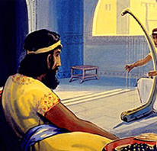
Drawing Nearer to God in Song
King David and His Harp
This Photo by Unknown Author is licensed under CC BY-NC-ND

Slide 3
Who Introduced Instruments into Worship?
King David himself
1 Chron. 25:1-7
1 Chron. 23:3-6
There is a difference in “Toleration” and “Commanded”
1 Sam. 8:4-9
Deut. 24:1-4 & Matt. 19:7-8
Isa. 5: 11-13 & Amos 5:16-27
REGARDLESS: the OT is NOT the authority we need today!
Rom. 7:4-6
Gal. 5:2-6

Slide 4
What Does the NT Say?
SILENCE!
The Word of God is COMPLETE!
2 Tim. 3:16-17
Jude 3
Faith is not the question
Eph. 5:16-21

Slide 5
Why Should We Fear the Usage?
It is Unscriptural
Expedience is not present
It must be LAWFUL (1 Cor. 6:12)
It must EDIFY not just the individual but the whole body (1 Cor. 10:23-24)
It must NOT cause offense (1 Cor. 10:28)

Slide 6
Modern Arguments “For” The Usage
“I/We are using our talents for God!”
“There is no law AGAINST it! Therefore, it cannot be a sin!”
1 Cor. 4:6
2 John 9
“The term “Psallo” used in both Ephesians and Colossians authorizes it!”

Slide 7
So…what ARE we to do then?!
Col. 3:16-17

