Slide 2
Introductory Remarks
The study of the Holy Spirit is a neglected one.
Because of this, there is a misunderstanding not only among the world concerning the Holy Spirit but among many Christians.
There are things we may not know – Deut. 29:29; Isa 55:8,9
BUT, there is a lot we can learn

Slide 3
The Holy Spirit in Scriptures
The Holy Spirit is referred to 88 times in the Old Testament
With 18 different names being applied to Him
He is referred to 264 times in the New Testament
With 39 different names being applied

Slide 4
Masculine Pronouns are Applied to Him
The Holy Spirit is a Divine “Person”
John 16:13:
“However, when He, the Spirit of truth, has come, He will guide you into all truth; for He will not speak of His own authority, but whatever He hears He will speak; and He will tell you things to come.”

Slide 5
Masculine Pronouns are Applied to Him
The Holy Spirit is a Divine “Person”
The Holy Spirit is NOT a glorified “it” nor a mystical “influence.”
He: speaks, teaches, testifies, has memory, guides, leads, forbids, and searches

Slide 6
His Attributes Show He is a Divine Person
The Holy Spirit is a Divine “Person”
Hebrews 9:14
He is eternal
1 Corinthians 2:10,11
He is omniscient
Psalms 139:7-12
He is omnipresent

Slide 7
The Godhead
The Holy Spirit is apart of the Godhead
There is a Godhead
Acts 17:29
Romans 1:20
Colossians 2:9
It is composed of three divine persons/beings
Matthew 28:19

Slide 8
The Godhead
The Holy Spirit is apart of the Godhead
Paul speaks of all three divine persons in the same verse
Romans 15:30
2 Corinthians 13:14
Ephesians 4:3-6 (Paul talks about 7 ones, and note 3 of them)
They all three possess deity, not three Gods, but one Godhead

Slide 9
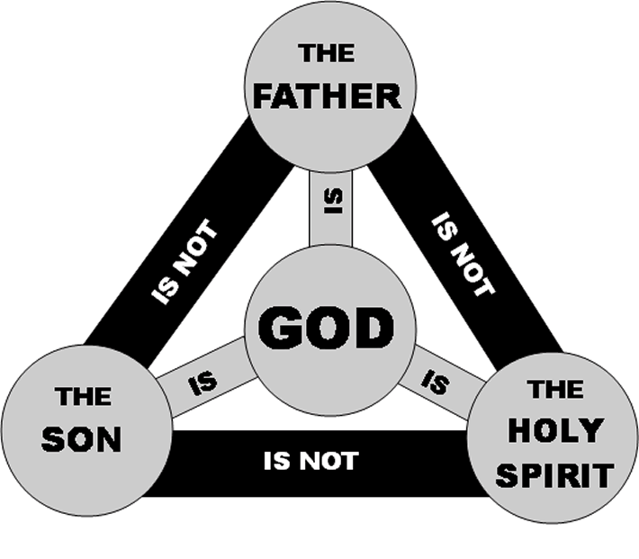
Pictorial Representation

Slide 10
The Godhead and Creation
The Holy Spirit is apart of the Godhead
To review, let’s take a look at the Godhead in creation.
Genesis 1:1 – based on rest of Scriptures, God must be understood as the Godhead
Verse 3 – God the Father said/commanded – Psalms 33:6-9
Son Created – Colossians 1:16

Slide 11
The Godhead and Creation
The Holy Spirit is apart of the Godhead
Holy Spirit witnessed – Genesis 1:2
1:26,27 – Note the pronouns. “And God said” – must be referencing Godhead
“. . . Let US make man in OUR image . . .”
V 27 – “God created man in HIS OWN image . . .”

Slide 12
The Godhead
The Holy Spirit is apart of the Godhead
The three persons of the Godhead are separate and distinct.
John 14:26
Note how all three are talked about their distinctiveness: we have the sender (the Father), the one sent (the Holy Spirit) and the one in whose name He is sent (Jesus).

Slide 13
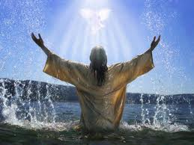
Matthew 3:13-17
The Holy Spirit is apart of the Godhead
The Father
speaks
The Spirit
descends
The Son is
baptized

Slide 14
The Godhead
The Holy Spirit is apart of the Godhead
There are three but they are distinct
God the Father is NOT God the Son or God the Holy Spirit
The Son is God; but he is not God the Father nor is he God the Holy Spirit
The Holy Spirit is God; but he is not God the Father nor is he God the Son
Not three Gods, but one essence (deity) possessed by all

Slide 15
The Godhead
Deut 6:4 “The Lord
God is ONE.”
The Father
God signifies deity. There
are three persons who
possess the nature of
Deity. The Father,
Son and Holy Ghost
IS
1 Cor.
1:3
IS NOT
IS NOT
1 John 1:3
Matt 3:16-17
GOD
IS
IS
John 1:1-14
Acts 5:3-4
The
Son
Jesus
The Holy Spirit
John 14:16
IS NOT

Slide 16
The Godhead
The Father…
The Son…
& The Holy Spirit
Distinct & Separate Spiritual Beings
Existing Together as Deity – the One God
United in Purpose and Will

