Slide 1
Letters to Corinth
Lessons for us all

Slide 2
Lesson Schedule for the Corinthian Letters
Lesson 1
Why should Corinthians listen to Paul?
(2 Cor. 10-13:10)
Lesson 2
Division in the Church
(1 Cor. 1-4)
Lesson 3
Lack of Discipline
(1 Cor 5-7)
Lesson 4
Conduct and Idolatry
(1 Cor 8-10)
Lesson 5
Humility in Worship
(1 Cor. 11)
Lesson 6
Spiritual Gits and Spiritual People
(1 Cor. 12-14, 16, 2 Cor. 8-9)
Lesson 7
Resurrection of Believers
(1 Cor. 15)
Lesson 8
Paul’s view of the Ministry
(2 Cor. 3-6)

Slide 3
Why Should Corinthians Listen to Paul?

Slide 4
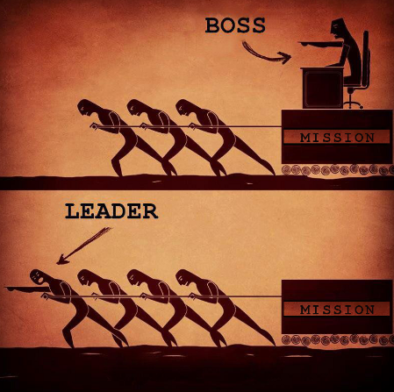
Leadership Qualities

Slide 5
Leadership Qualities
Leading By Example
Wise Christian leaders do not consider themselves to be better than the everyone else or above adhering to biblical principles.

Slide 6
Leadership Qualities
Leading By Example
Humility
It’s Christian leader’s duty to embrace a humble mindset, meekness of heart, and Christ-like humility in their behaviors.

Slide 7
Leadership Qualities
Leading By Example
Humility
Integrity
1 Tim 4:16 Keep a close watch on yourself and on the teaching. Persist in this, for by so doing you will save both yourself and your hearers.

Slide 8
Leadership Qualities
Leading By Example
Humility
Integrity
Love
Faith is infused with the light of love. By embracing this principle of Christian leadership, leaders can strive to keep their motives pure.

Slide 9
Leadership Qualities
Leading By Example
Humility
Integrity
Love
Growing/Maturing Leaders
A strong Christian leader who is followed by others must understand the importance of empowering members with information, tools, skills, and personal development opportunities. If followers lack the ability to become leaders, they will remain enslaved as followers.

Slide 10
Leadership Qualities
Leading By Example
Humility
Integrity
Love
Growing/Maturing Leaders
Servant Leadership
Servant leadership involves respecting those around you and placing their best interests ahead of yourself.

Slide 11
Leadership Qualities
Leading By Example
Humility
Integrity
Love
Growing/Maturing Leaders
Servant Leadership
Visionary
An effective Christian leader must be a follower of God’s Word and must carry out The Lord’s command to spread The Word. Every possible teaching situation must have a vision, to serve God and to serve the community the Christians are in.

Slide 12
Why should Corinthians listen to Paul?
2 Corinthians 10:1-6
What did Paul mean that he was humble when present and bold when absent?
What response was Paul hoping for among the Corinthians?
Why might he need to show boldness to the Corinthians the next time he saw them?
What does Paul claim to destroy and for who?

Slide 13
Why should Corinthians listen to Paul?
2 Corinthians 10:7-11
How does meekness and humility go together with strength?

Slide 14
Why should Corinthians listen to Paul?
2 Corinthians 10:12-18
What leadership qualities of Paul are evident from vs 13-18?

Slide 15
Why should Corinthians listen to Paul?
2 Corinthians 10 Recap
How does Paul fit the Leadership qualities? Examples?
Leading By Example
Humility
Integrity
Love
Growing/Maturing Leaders
Servant Leadership
Visionary

Slide 16
Why should Corinthians listen to Paul?
2 Corinthians 11:1-15
How does Paul view his relationship to the church at Corinth?
What can we suppose about the Super-Apostles from verses 7-15?

Slide 17
Why should Corinthians listen to Paul?
2 Corinthians 11:16-33
Explain Paul’s attitude toward boasting from verses 17-21.
What Leadership quality do we see in verse 23-28?

Slide 18
Why should Corinthians listen to Paul?
2 Corinthians 11 Recap
How does Paul fit the Leadership qualities? Examples?
Leading By Example
Humility
Integrity
Love
Growing/Maturing Leaders
Servant Leadership
Visionary

Slide 19
Why should Corinthians listen to Paul?
2 Corinthians 12:11-18
What relationship does Paul does recall to their minds, between the church at Corinth and himself?
How would you describe Paul and these messengers’ actions while being among the Corinthians (12:14-19)?
What does he assure them his motives have been (12:19)?

Slide 20
Why should Corinthians listen to Paul?
2 Corinthians 12 Recap
How does Paul fit the Leadership qualities? Examples?
Leading By Example
Humility
Integrity
Love
Growing/Maturing Leaders
Servant Leadership
Visionary

Slide 21
Why should Corinthians listen to Paul?
2 Corinthians 13:1-10
What is Paul’s final concern?

Slide 22
Why should Corinthians listen to Paul?
2 Corinthians 10-13 Recap
How does Paul fit the Leadership qualities? Examples?
Leading By Example
Humility
Integrity
Love
Growing/Maturing Leaders
Servant Leadership
Visionary

